Slide 1
Rankings4U
Client Name: Luminal Inc.
Date: 11-29-2016
Group: 0502-13
Members:
Davuloori Sree Pradyumna
Krishna Srikar Ganti
Lakshmi Narasimhan Narayanan
Rohith V Thomas

Slide 2
Background
Luminal Inc is a cloud based solution provider.
They are looking for a web based consolidated rankings system to help students in their search for the best graduate school that suits their needs.
After lengthy brainstorming, we zeroed in on a web based rankings decision engine, creating an one-stop website to help in comparing and selecting universities.
The application sources data from credible sources of rankings and in addition, provides a “weighted rank” using a well tested and proven algorithm to reduce inconsistencies in University Rankings.

Slide 3
Data Sources
Our application sources it’s ranking data from the following credible sources:
US News- www.usnews.com
TFE Times- www.tfetimes.com
Masters in Data Science- www.mastersindatascience.org
College Choice- www.collegechoice.net
The Economist - www.economist.com
Corresponding websites of universities.

Slide 4
Mission Statement and Objectives
Mission Statements:
A comprehensive and flexible search engine for rankings of business programs to cater to the needs of aspiring students and academic executives.
Mission Objectives:
Consolidate ranking information from various credible sources allowing users to make better and informed decisions.
Eliminate uncertainty regarding rankings by providing a weighted rank.
Assist decision makers of academic institutions by comparing rankings of their competitors with their own.
Conveniently filter rankings based on region, tuition and top five universities.

Slide 5
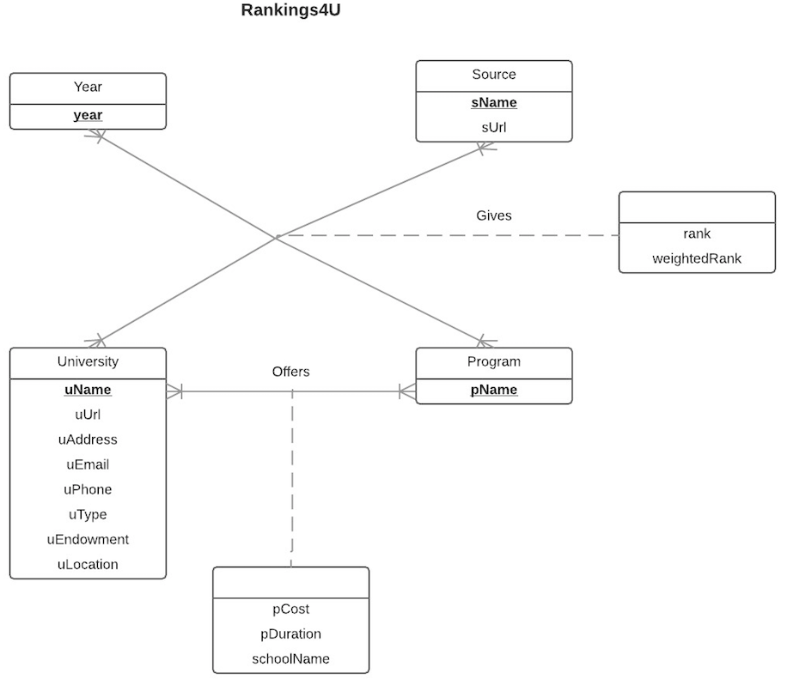
Conceptual Database Design

Slide 6
Logical Database Design
Relational Schema:
Year(year)
Source(sName, sUrl)
University(uName, uUrl, uEmail, uPhone, uType, uEndowment, uLocation)
Program(pName)
Gives(rankId, year, sName, uniName, pName, rank, weightedRank)
Offers(uniName, pName, pCost, pDuration,schoolName)

Slide 7
Physical Database Design
An SQL CREATE statement for a relation which contains four foreign keys:
CREATE TABLE [Rankings4U.Gives]
(rankId CHAR(10) NOT NULL,
year INTEGER,
sName varchar(35),
uName varchar(35),
pName varchar(35),
rank INTEGER,
weightedRank INTEGER
CONSTRAINT pk_Gives_rankId PRIMARY KEY(rankId),
CONSTRAINT fk_Gives_year FOREIGN KEY(year) REFERENCES [Rankings4U.Year] (year)
ON DELETE CASCADE ON UPDATE CASCADE,
CONSTRAINT fk_Gives_sName FOREIGN KEY(sName) REFERENCES [Rankings4U.Source] (sName)
ON DELETE CASCADE ON UPDATE CASCADE,
CONSTRAINT fk_Gives_pName FOREIGN KEY(pName) REFERENCES [Rankings4U.Program] (pName)
ON DELETE CASCADE ON UPDATE CASCADE,
CONSTRAINT fk_Gives_uName FOREIGN KEY(uName) REFERENCES [Rankings4U.University] (uName)
ON DELETE CASCADE ON UPDATE CASCADE)

Slide 8
Application Features
A Comprehensive database of rankings for more than 30 universities in various programs.
A custom search for rankings of a program filtered by location of the university
A custom search for rankings of a program filtered by cost of tuition.
A in-house calculated ‘weighted rank’ that weighs the reputation of the university and reduces the variability of rank across sources and years.
A different view for university executives called university view to help them identify their close competitors.

Slide 9
Technologies Used

Slide 10

Home Page

Slide 11
Business Transaction 1
What are the top 5 universities in MBA program in the year 2015 as per US News?
PHP Implementation:
SELECT * FROM gives WHERE (sName IN ('$sname_ids')) AND (year IN ('$year_ids')) AND (pName IN ('$program_ids')) ORDER BY year DESC, pName, weightedRank DESC, rank LIMIT 5
My SQL Query:
SELECT year, sName, uName, pName, rank, weightedRank FROM gives WHERE pName='MBA' AND year= 2015 AND sName='US News' ORDER BY year DESC, pName, weightedRank DESC, rank LIMIT 5

Slide 12
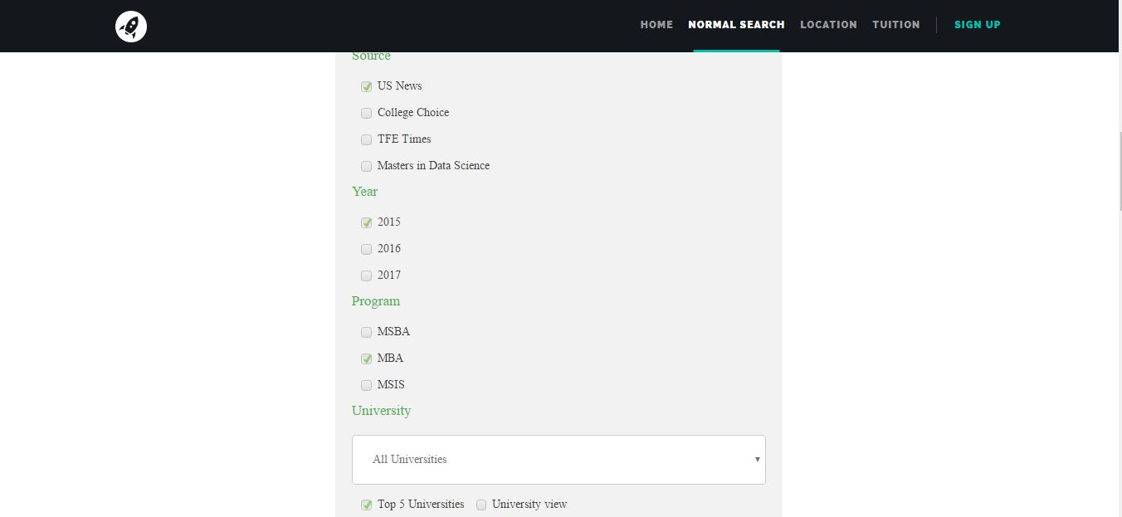
What are the top 5 universities in MBA program in the year 2015 as per US News?

Slide 13
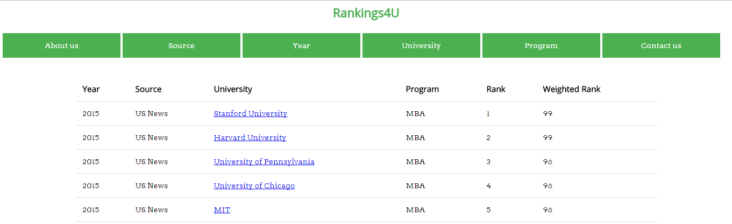
What are the top 5 universities in MBA program in the year 2015 as per US News?

Slide 14
Business Transaction 2
What are the top universities offering MIS Program in the North-East part of USA?
PHP Implementation:
SELECT g.year, g.sName, g.uniName, g.pName, g.rank, g.weightedRank FROM gives g, university u WHERE (g.uniName = u.uniName) AND u.uLocation IN ('$region') AND g.pName IN ('$program_ids') ORDER BY year DESC, pName, weightedRank DESC, rank
My sql query:
SELECT g.year, g.sName, g.uniName, g.pName, g.rank, g.weightedRank FROM gives g, university u WHERE g.pName='MIS' AND u.uLocation='North-East' AND g.uniName=u.uniName ORDER BY year DESC, pName, weightedRank DESC, rank

Slide 15
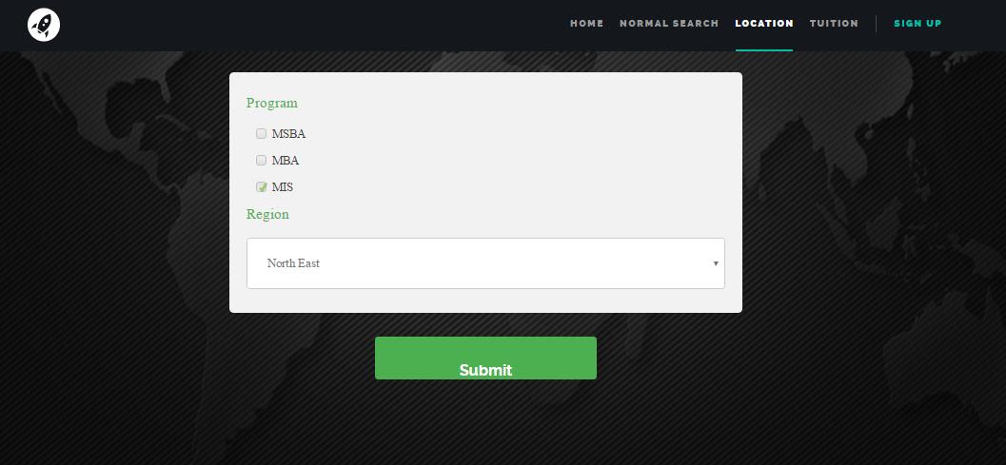
What are the top universities offering MIS Program in the North-East part of USA?

Slide 16
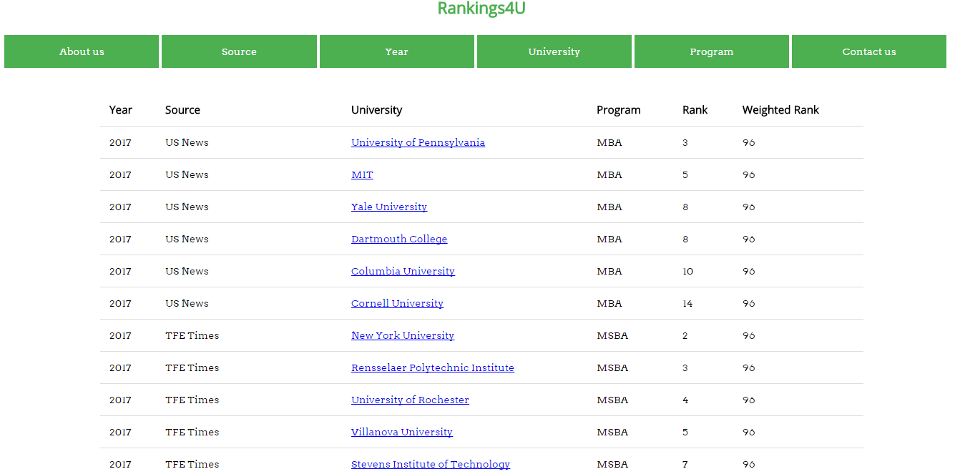
What are the top universities offering MIS Program in the North-East part of USA?

Slide 17




The Team
Davuloori Sree Pradyumna
Krishna Srikar Ganti
Lakshmi Narasimhan Narayanan
Rohith V Thomas

Slide 18
Thank You

